Slide 1
Cloud Infrastructure Management CSE 5213

Slide 2
Course objectives: This course will enable students to
To gain competence in cloud computing properties, Deployment models, and service models
To gain knowledge in cloud architecture, Cloud virtualization.
To Design and development of cloud architectural solution with its detailed monitoring to enhance the resource utilization
To Analyze the cloud Infrastructure Security and compliances to solve security breach in cloud environment

Slide 3
Module 1: INTRODUCTION TO CLOUD COMPUTING
→ Cloud Computing in a Nutshell
Roots of Cloud Computing
Benefits and challenges of cloud computing,
public vs private clouds,
role of virtualization in enabling the cloud
Business Agility: Benefits and challenges to Cloud architecture,
Application availability, performance, security and disaster recovery
Next generation Cloud Applications.
(Text Book 1 & 2) (8 Hrs)
Barrie Sosinsky, “Cloud Computing Bible”, Wiley-India, 2010 (Text Book 1)
Rajkumar Buyya, James Broberg, Andrzej Goscinski “Cloud Computing Principles and Paradigms” Wiley Publications , 2013 (Text Book 2)

Slide 4
Module 2: VIRTUALIZATION AND EXPLORING PLATFORM
Virtualization concept, Types of virtualizations, Demo of virtualization, Virtualization Merits,
Role of virtualization in cloud computing,
Virtualization Demerits,
VM Placement, VM Migration, VM Migration Demo, VM clustering,
Design Issues in VM Clustering, Need of Dockers and Containers, Docker Eco-System, Hypervisor Vs. Docker,
Exploring Platform as a Service, Using Google Web Services, Using AWS (Amazon Web Services), Using Microsoft Cloud Services (12 Hrs)
Barrie Sosinsky, “Cloud Computing Bible”, Wiley-India, 2010
(Text Book 1)
Rajkumar Buyya, James Broberg, Andrzej Goscinski “Cloud Computing Principles and Paradigms” Wiley Publications , 2013 (Text Book 2)

Slide 5
Module 3: EXPLORING CLOUD INFRASTRUCTURE:
Managing the Cloud: Administrating the Clouds,
Management responsibilities,
Lifecycle management,
Emerging Cloud Management Standards,
Understanding Cloud Security: Securing the Cloud, The security boundary, Security mapping, Securing Data, Encryption, Auditing and compliance, Establishing Identity and Presence (10 Hrs)
Barrie Sosinsky, “Cloud Computing Bible”, Wiley-India, 2010
(Text Book 1)
Rajkumar Buyya, James Broberg, Andrzej Goscinski “Cloud Computing Principles and Paradigms” Wiley Publications , 2013 (Text Book 2)
Relevant research papers

Slide 6
Module 4: UNDERSTANDING SERVICES AND APPLICATIONS
Introducing Service Oriented Architecture,
Event-driven SOA or SOA 2.0, The Enterprise Service Bus,
Service catalogs, Managing and Monitoring SOA,
SOA management tools, SOA security,
The Open Cloud Consortium ,
Relating SOA and Cloud Computing, Data Center Management Tools, Service Management in Cloud Computing - Service Level Agreements(SLAs),
Billing & Accounting - Comparing Scaling , Hardware: Traditional vs. Cloud, Economics of scaling: Benefitting enormously (10 Hrs)

Slide 7
Module 5: MANAGING DATA AND CASE STUDIES
Managing Data - Looking at Data,
Scalability & Cloud Services, Database & Data Stores in Cloud
- Large Scale Data Processing
SDL: Cloud Infrastructure market analysis and Case Studies, Security and Compliances,
Establishing Identity and presence (8 Hrs)

Slide 8
Course outcomes: This course will enable students to
To articulate the building blocks of cloud infrastructure in the current industry scenario
To identify the design principles of virtualization techniques in cloud resource management
To design the cloud infrastructure using infrastructure as code.
To design and development of cloud architectural solution with its detailed monitoring.
To identify and analyze the cloud Infrastructure Security and compliances

Slide 9
INTRODUCTION TO CLOUD COMPUTING
1.1 Cloud Computing in a Nutshell
1.2 Roots of Cloud Computing
1.2.1 Mainframe to clouds ,
1.2.2 SOA, Web Services, Mashups
1.2.3 Grid Computing
1.2.4 Utility Computing
1.2.5 Hardware Virtualization
1.2.7 Autonomic Computing
1.3Layers and Types of Clouds
1.3.1 Infrastructure as Service
1.3.2 Platform as a Service
1.3.3 Software as Service
1.3.4 Deployment Models

Slide 10
INTRODUCTION TO CLOUD COMPUTING
1.4 Desired Features of a Cloud
1.4.1 Self Service
1.4.2 Per Usage Metering and Billing
1.4.3 Elasticity
1.4.4 Customization
Cloud Infrastructure Management
Infrastructure as a Service Providers , Platform as a Service Providers ,Challenges and Risks, public clouds, private clouds, hybrid clouds.

Slide 11
INTRODUCTION TO CLOUD COMPUTING
What is Cloud Infrastructure Management?
What is Cloud Computing?
Different perspectives
Properties and characteristics
Benefits from cloud computing
Service and deployment models
Three service models
Four deployment models
Notes:
What is the cloud infrastructure?
Cloud Infrastructure is the collection of hardware and software elements such as computing power, networking, storage, and virtualization resources needed to enable cloud computing. Cloud infrastructure types usually also include a user interface (UI) for managing these virtual resources.
What do you mean by cloud infrastructure management?
Cloud infrastructure management comprises the processes and tools needed to effectively allocate and deliver key resources when and where they are required

Slide 12

What is Cloud Computing ?

Slide 13
What is cloud computing….. Cloud computing is the delivery of computing services—servers, storage, databases, networking, software and more—over the Internet (“the cloud”). Companies offering these computing services are called cloud providers and typically charge for cloud computing services based on usage, similar to how you are billed for water or electricity at home.

Slide 14
Cloud Computing In A Nutshell
Virtualization means delivering useful functions while hiding how internals work
Cluster, grid, and now, cloud computing, have all aimed at allowing access to large amounts of computing power in a fully virtualized manner
By aggregating resources
By offering a single system view

Slide 15
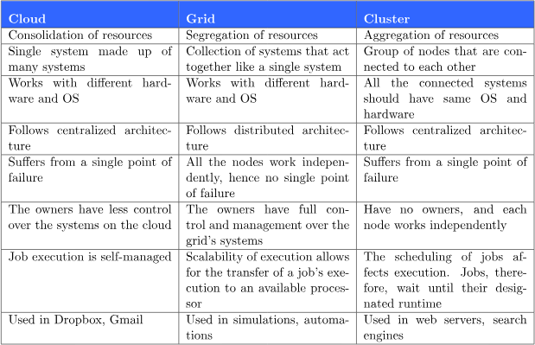
Cloud vs. Grid vs. Cluster

Slide 16
Features of Cloud
Self Service
Per usage metering and billing
Elasticity
Resources are abstracted or virtualized

Slide 17
Self-Service
Consumers of cloud computing services expect on-demand
Nearly instant access to resources
Clouds must allow self-service access
Customers can request, customize, pay, and use services without intervention of human operators
Notes:
1.4.1 Self-Service

Slide 18
Per-Usage Metering and Billing
Cloud computing eliminates up-front commitment by users
Allowing them to request and use only the necessary amount
Services must be priced on a short-term basis, e.g., by the hour
Allowing users to release (and not pay for) resources as soon as they are not needed
Clouds must allow efficient trading of service
Such as pricing, accounting, and billing
Metering should be done accordingly for different types of service
e.g., storage, processing, and bandwidth
Usage is promptly reported
Thus providing greater transparency
Notes:
1.4.2 Per-Usage Metering and Billing

Slide 19
Elasticity
Cloud computing gives the illusion of infinite computing resources available on demand
Users expect clouds to rapidly provide resources in any quantity at any time
The additional resources can be
Provisioned, possibly automatically, when an application load increases
Released when load decreases
Scale up and down
Notes:
1.4.3 Elasticity

Slide 20
Resources are abstracted or virtualized
Virtualization is a technology that can be used to create a virtual representation of servers, storage, networks, and other physical machines
VM mimics the function of a physical machine
Virtualization enables multiple VMs to run on a single physical server

Slide 21
Cloud Computing In A Nutshell (cont.)
Delivering computing as a utility
A business model for on-demand delivery of computing power
Consumers pay providers based on usage
Pay-as-you-go
Similar to services from traditional public utility services
e.g., water, electricity, gas, and telephony
A category of sophisticated on-demand computing services initially offered by commercial providers
e.g., Amazon, Google, and Microsoft

Slide 22
Cloud Computing In A Nutshell (cont.)
Cloud computing providers usually offer a broad range of software services
In addition to raw computing and storage
Include APIs and development tools
Allow developers to build seamlessly scalable applications upon their services
Allow customers to run their everyday IT infrastructure “in the cloud”
Delivering computing as a utility has been realized with the advent of cloud computing
The main technological advancements
Public clouds, management tools, and development frameworks

Slide 23
So the main aim of this computing model is offering computing, storage and software as a service.
Definition from Buyya
A Cloud is a type of parallel and distributed system consisting of a collection of interconnected and virtualized computers that are dynamically provisioned and presented as one or more unified computing resources based on service-level agreements established through negotiation between the service provider and consumers.
Cloud provisioning is the allocation of a cloud provider's resources to a customer.

Slide 24
Cloud Definitions
Definition from NIST (National Institute of Standards and Technology)
Cloud computing is a model for enabling convenient, on-demand network access to a shared pool of configurable computing resources (e.g., networks, servers, storage, applications, and services) that can be rapidly provisioned and released with minimal management effort or service provider interaction.
This cloud model promotes availability and is composed of some essential characteristics, three service models, and four deployment models.

Slide 25
Cloud Definitions
Definition from Wikipedia
Cloud computing is Internet-based computing, whereby shared resources, software, and information are provided to computers and other devices on demand, like the electricity grid.
Cloud computing is a style of computing in which dynamically scalable and often virtualized resources are provided as a service over the Internet.

Slide 26
Cloud Definitions
A report from the University of California Berkeley summarized the key characteristics of cloud computing as:
(1) the illusion of infinite computing resources;
(2) the elimination of an up-front commitment by cloud users;
(3) the ability to pay for use . . . as needed . . .”

Slide 27
Cloud Definitions
Common characteristics among the notable cloud definition
Pay per use
Elastic capacity and the illusion of infinite resources
Self-service interface
Resources that are abstracted or virtualized

Slide 28
Roots of Cloud Computing
Roots of cloud computing can be tracked by observing the advancement in technologies….
hardware (virtualization, multi-core chips)
Internet technologies (Web services, service-oriented architectures, Web 2.0)
distributed computing (clusters, grids)
systems management (autonomic computing, data center automation).

Slide 29
Roots Of Cloud Computing (cont.)
Notes:
1.2 Roots Of Cloud Computing
FIGURE 1.1

Slide 30
Mainframe Computers
Mainframes are a type of computer that generally are known for their large size, amount of storage, processing power and high level of reliability.
A single mainframe can replace dozens or even hundreds of smaller servers.
Widely used area are banking, finance, health care, insurance, public utilities, government etc
Mainframes are able to handle large workloads, and their reliability, scalability and performance make them the system of choice for many organizations for bulk processing, handling transactions and for maintaining vital business records.

Slide 31
Mainframes to Clouds
Mainframes had to operate at very high utilization rates and were very expensive.
The mainframe era collapsed with the advent of fast and inexpensive microprocessors(multi-core processors) .
Next Cloud Computing have sprung up, allowing applications to be run via third-party infrastructure that requires little or no hardware investment and services to be paid for as they are needed.
The advent of fast fiber optic networks , helped enabling sharing of computing power over great distances.

Slide 32
SOA, Web Services, Web 2.0, and Mashups :
Q1: What is web Service?
Q2: What are the tasks performed by web service?
Q3: What is SOA?
Q4. What are the benefits of using SOA?
Q5: COMPONENTS of SOA?

Slide 33
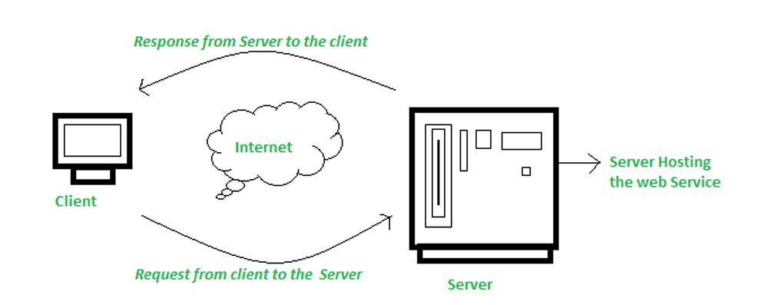
SOA, Web Services, Web 2.0, and Mashups :
What is web Service?
Web services are applications or software that use standardized web protocols to communicate and exchange data over the internet. They can be either a service offered by one electronic device to another, or a server that listens for requests on a computer device.

Slide 34
SOA, Web Services, Web 2.0, and Mashups :
Q2: What are the tasks performed by web service?
Interoperability:
A2A communication:
Streamlining connectivity:
Minimizing development time:
Efficient technology distribution:

Slide 35
SOA, Web Services, Web 2.0, and Mashups :
Q3: What is SOA?
Service-oriented architecture (SOA) is an evolution of distributed computing based on the request/reply design paradigm for synchronous and asynchronous applications
Service-oriented architecture (SOA) is a method of software development that uses software components called services to create business applications

Slide 36
SOA, Web Services, Web 2.0, and Mashups
Q4: How does service-oriented architecture work?
In service-oriented architecture (SOA), services function independently and provide functionality or data exchanges to their consumers.
The consumer requests information and sends input data to the service. The service processes the data, performs the task, and sends back a response. For example, if an application uses an authorization service, it gives the service the username and password. The service verifies the username and password and returns an appropriate response.

Slide 37
SOA, Web Services, Web 2.0, and Mashups
Q5: COMPONENTS of SOA?
Service
Service interface
Service provider
Service Consumer
Service Registry

Slide 38
SOA, Web Serices, Web 2.0, and Mashups
Q5: How does SOA work?
In service-oriented architecture (SOA), services function independently and provide functionality or data exchanges to their consumers.
The consumer requests information and sends input data to the service. The service processes the data, performs the task, and sends back a response.

Slide 39
SOA, Web Serices, Web 2.0, and Mashups
Q5: How does SOA work?
In service-oriented architecture (SOA), services function independently and provide functionality or data exchanges to their consumers.
The consumer requests information and sends input data to the service. The service processes the data, performs the task, and sends back a response.
REST and SOAP are two different approaches to online data transmission and application programming interfaces (APIs) in a service-oriented architecture (SOA):

Slide 40
SOA, Web Serices, Web 2.0, and Mashups
REST vs. SOAP
REST (Representational State Transfer):
Architectural Style: A set of guidelines, not a strict protocol.
Lightweight: Uses standard HTTP methods (GET, POST, PUT, DELETE).
Data Formats: Flexible (JSON, XML, plain text, HTML).
Stateless: Each request is independent, great for scalability.
Cloud Fit: Ideal for web/mobile apps, microservices, and high-performance APIs.

Slide 41
SOA, Web Serices, Web 2.0, and Mashups
REST vs. SOAP
SOAP (Simple Object Access Protocol):
Protocol: A standardized, complex messaging protocol.
XML-Only: Strictly uses XML for messages.
Stateful/Transactional: Supports complex transactions (ACID compliance) and WS-Security.
Cloud Fit: Best for enterprise-level systems needing high security, reliability (finance, healthcare).

Slide 42
SOA, Web Services, Web 2.0, and Mashups
REST technology is generally preferred to the more robust technology because REST leverages less bandwidth, making it more suitable for internet usage.
Many service providers make their service APIs publicly accessible using standard protocols like SOAP and REST
Amazon, Facebook, and Google

Slide 43
SOA, Web Services, Web 2.0, and Mashups :
Mashups
Acting as building blocks of complex compositions, called service mashups
Mashups: Web applications that dynamically combine data and services from multiple sources (often cloud-based APIs) to create a new, richer application, often client-side (JavaScript) or server-side.
Services like user authentication, e-mail, payroll management, and calendars are examples
Can be reused and combined in a business solution
Popular APIs are combined to produce a variety of interesting solutions
Google Maps, youtube, Amazon ecommerce, and Twitter

Slide 44
A mashup is a Web page or application that uses and combines data, presentation or functionality from two or more sources to create new services.
Combination with Google Maps HousingMaps: combines rental listings (American classified advertisements website with sections devoted to jobs, housing, personals, for sale, items wanted, services, community and discussion forums.) with Google Maps for a visual representation of local apartments for rent.
Wikipedia vision: combines Google Map and a Wikipedia API
Notes:
Wikipedia vision: Google Maps API and the Wikipedia API to display, in near real-time, the geographic locations of users making edits to the English Wikipedia.

Slide 45
Grid Computing
Grid Computing enables aggregation of distributed resources .
It is a type of parallel and distributed system that enables the sharing, exchange, selection, & aggregation of geographically distributed resources depending on their availability, capability, cost, and user QoS requirements.
Open Grid Service Architecture(OGSA) – helps in standardization by defining a set of core capabilities and behaviors.

Slide 46
Issues in grid
→ Guaranteeing execution time for critical applications
Availability of resources with diverse configuration
Virtualization technology helped in finding the solution of some of the issues.
Some characteristics of Grid…
numerous
owned and managed by different, multiple organisations and individuals.
have different security requirements and policies
heterogeneous
connected by heterogeneous, multilevel networks
have different resource management policies
Likely to be geographically separated

Slide 47
Utility Computing
Utility Computing
Large grid installation faced new problems, failed to ensure fair and equitable access to resources to meet the deadline
Core Idea: On-demand access to computing resources (CPU, storage) with pay-per-consumption pricing, similar to electricity or water.
Focus: Primarily on infrastructure, raw power, and cost-effectiveness for basic needs.
Example: Early models of renting server time.

Slide 48
Cloud Computing
Core Idea: Delivers a wide range of IT services (infrastructure, platforms, software, databases, AI) over the internet, built on utility principles.
Focus: An entire ecosystem for rapid development, scalability, and innovation, managing complexity.
Examples: Amazon Web Services (AWS), Microsoft Azure, Google Cloud Platform (GCP) offering IaaS, PaaS, SaaS.

Slide 49
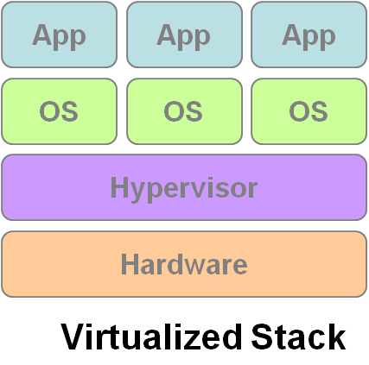
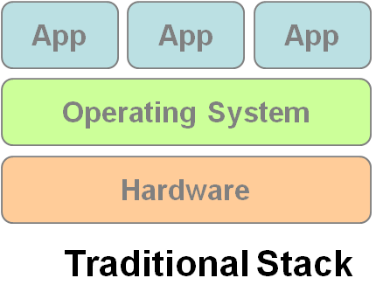
Hardware Virtualization
Cloud computing services are usually backed by large-scale data centers composed of thousands of computers.
Such data centers are built to serve many users and host many disparate applications.
For this purpose, hardware virtualization can be considered as a perfect fit to overcome most operational issues of data center building and maintenance.
Virtualization enhances :sharing and utilization of computer systems
VM1
VM2
VM3

Slide 50
H/w virtualization allows running multiple OS and a s/w stacks on a single physical platform
VMM (virtual machine monitor) also called hypervisor mediates access to physical hardware presenting each guest OS a VM
A number of VMM platforms like VMWare, Xen…. that are the basis of many utility or cloud computing environments.
Benefits
Sharing and utilization
Better manageability
Higher reliability

Slide 51
Three basic capabilities regarding management of workload:
Workload isolation-A virtual machine should not be able to read RAM that is in use by another virtual machine. It also should not be able to access another virtual machine’s disk.
Workload migration - encapsulating guest OS system state within VM and allowing it to suspend or migrate to different platforms and resumed immediately…( facilitates h/w maintenance, load balancing and disaster recovery).
Workload consolidation – Consolidation of several individual and heterogenous workloads onto a single platform leads to better system utilization.

Slide 52
Autonomic Computing
The increasing complexity of computing systems has motivated research on autonomic computing, which seeks to improve systems by decreasing human involvement in their operation.
In other words, systems should manage themselves, with high-level guidance from humans
Autonomic, or self-managing, systems rely on monitoring probes and gauges (sensors), on an adaptation engine (autonomic manager) for computing optimizations based on monitoring data, and on effectors to carry out changes on the system
Notes:
Forest fire monitoring

Slide 53
The large data centers of cloud computing providers must be managed in an efficient way. In this sense, the concepts of autonomic computing inspire software technologies for data center automation, which may perform tasks such as:
→management of service levels of running applications; →management of data center capacity;
→proactive disaster recovery;
→automation of VM provisioning

Slide 54
What is Cloud Computing?
Cloud Computing is a general term used to describe a new class of network based computing that takes place over the Internet,
–basically a step on from Utility Computing
–a collection/group of integrated and networked hardware, software and Internet infrastructure (called a platform).
–Using the Internet for communication and transport provides hardware, software and networking services to clients
-
These platforms hide the complexity and details of the underlying infrastructure from users and applications by providing very simple graphical interface or API (Applications Programming Interface).

Slide 55
What is Cloud Computing?
In addition, the platform provides on demand services, that are always on, anywhere, anytime and any place.
•Pay for use and as needed, elastic
–scale up and down in capacity and functionalities
•The hardware and software services are available to
–general public, enterprises, corporations and businesses markets

Slide 56
Cloud Summary
Cloud computing is an umbrella term used to refer to Internet based development and services
•A number of characteristics define cloud data, applications services and infrastructure:
–Remotely hosted: Services or data are hosted on remote infrastructure.
–Ubiquitous: Services or data are available from anywhere.
–Commodified: The result is a utility computing model similar to traditional that of traditional utilities, like gas and electricity -you pay for what you would want!

Slide 57
Cloud computing architecture
As we know, cloud computing technology is used by both small and large organizations to store the information in cloud and access it from anywhere at any time using the internet connection.
Cloud computing architecture is a combination of service-oriented architecture and event-driven architecture.
Cloud computing architecture is divided into the following two parts –
Front End
Back End

Slide 58
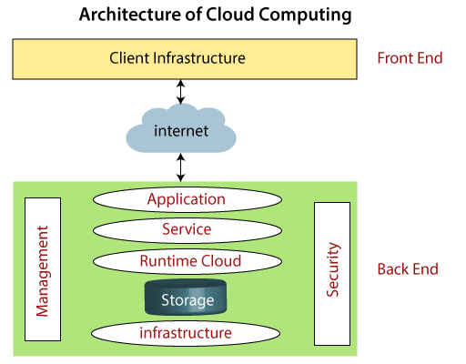
Cloud computing architecture

Slide 59
Cloud computing architecture
Front End
The front end is used by the client.
It contains client-side interfaces and applications that are required to access the cloud computing platforms.
The front end includes web servers (including Chrome, Firefox, internet explorer, etc.), thin & fat clients, tablets, and mobile devices.
Back End
The back end is used by the service provider.
It manages all the resources that are required to provide cloud computing services.
It includes a huge amount of data storage, security mechanism, virtual machines, deploying models, servers, traffic control mechanisms, etc.

Slide 60
Cloud computing architecture
Front End
Client Infrastructure – Client Infrastructure is a part of the frontend component. It contains the applications and user interfaces which are required to access the cloud platform.
In other words, it provides a GUI( Graphical User Interface ) to interact with the cloud

Slide 61
Cloud computing architecture
Back End
Backend refers to the cloud itself which is used by the service provider. It contains the resources as well as manages the resources and provides security mechanisms. They are
Application –
Service –
Runtime Cloud-
Storage –
Infrastructure –

Slide 62
Cloud computing architecture
Back End
Backend refers to the cloud itself which is used by the service provider. It contains the resources as well as manages the resources and provides security mechanisms. They are
Application –
Service –
Runtime Cloud-
Storage –
Infrastructure –

Slide 63
Cloud computing architecture
Back End resources
6. Management
7. Security
8. Internet
9. Database
10. Networking
11. Analytics

Slide 64

Service Models
Choose the service you need.

Slide 65

A Simple Analogy
Say, you just moved to a city and you are looking for a place to live.

Slide 66

What is your choice ?
Build a new house ?
Buy an empty house ?
Live in a hotel ?

Slide 67

Let’s build a new house !!
You can fully control everything you like your new house to have. But that is a hard work …

Slide 68

If you buy an empty house ?
You can customize some part of your house. But never change the original architecture.

Slide 69

How about live in a hotel ?
Live in a hotel will be a good idea if the only thing you care is enjoy your life!! There is nothing you can do with the house except living in it.

Slide 70
Let’s translate to Cloud Computing !!

Slide 71
Service Models Overview
What if you want to have an IT department ?
Similar to build a new house in previous analogy
You can rent some virtualized infrastructure and build up your own IT system among those resources, which may be fully controlled.
Technical speaking, use the Infrastructure as a Service (IaaS) solution.
Similar to buy an empty house in previous analogy
You can directly develop your IT system through one cloud platform, and do not care about any lower level resource management.
Technical speaking, use the Platform as a Service (PaaS) solution.
Similar to live in a hotel in previous analogy
You can directly use some existing IT system solutions, which were provided by some cloud application service provider, without knowing any detail technique about how these service was achieved.
Technical speaking, use the Software as a Service (SaaS) solution.

Slide 72
From Pizza Perspective

Slide 73
From Cloud Computing Perspective

Slide 74
From Usage Perspective

Slide 75
Availability in the Market

Slide 76
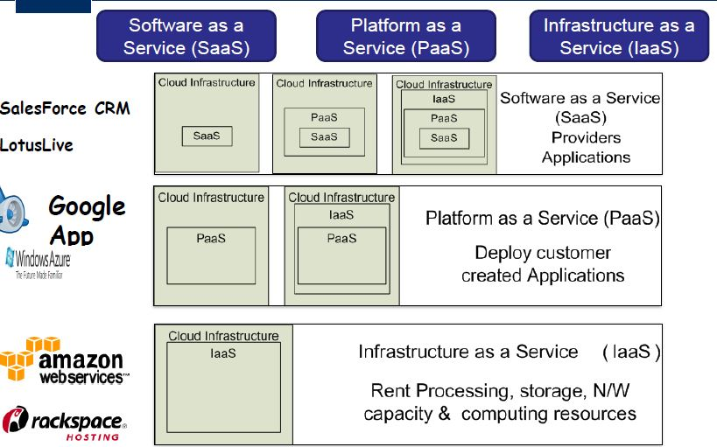
Cloud Service Models

Slide 77
Continued…..
Infrastructure as a Service (IaaS): hardware is provided by an external provider and managed for the customers
Platform as a Service (PaaS): in addition to hardware, your operating system layer is managed …..
Software as a Service (SaaS): further to the above, an application layer is provided and managed for you

Slide 78
Service Models
Infrastructure as a Service
Platform as a Service
Software as a Service

Slide 79
Infrastructure as a Service
Infrastructure as a Service – IaaS
The capability provided to the consumer is to provision processing, storage, networks, and other fundamental computing resources where the consumer is able to deploy and run arbitrary software, which can include operating systems and applications.
The consumer does not manage or control the underlying cloud infrastructure but has control over operating systems and deployed applications, and possibly limited control of networking components .
The cloud computing service provider manages the infrastructure, - customers - install, configure and manage their own software like —operating systems, middleware and applications

Slide 80
Examples :
Amazon EC2 - Amazon Elastic Compute Cloud (EC2) - allowing users to rent virtual computers on which to run their own computer applications.
OpenNebula - OpenNebula is a cloud computing platform for managing heterogeneous distributed data center infrastructures
Amazon Web Services (AWS) and
Google Cloud Platform (GCP) are examples of independent IaaS providers

Slide 81
Service Models
Infrastructure as a Service
Platform as a Service
Software as a Service

Slide 82
Platform as a Service
Platform as a Service - PaaS
The consumer does not manage or control the underlying cloud infrastructure including network, servers, operating systems, or storage, but has control over the deployed applications.
Apart from servers, storage and networking—it also includes middleware, development tools, business intelligence (BI) services, database management systems and more…
Can avoid the expense and complexity of buying software licenses, and managing the underlying application infrastructure and middleware or the development tools and other resources

Slide 83
Examples :
Microsoft Windows Azure - Microsoft Azure is a growing collection of cloud services for building, deploying and managing applications through global network of datacentres.
Google App Engine- Google App Engine is a fully managed platform that completely abstracts away infrastructure so user can focus only on code.
Hadoop- Hadoop is an open source, Java-based programming framework that supports the processing and storage of extremely large data sets in a distributed computing environment.

Slide 84
Service Models
Infrastructure as a Service
Platform as a Service
Software as a Service

Slide 85
Software as a Service
A layer on top on PAAS
The capability provided to the consumer is to use the provider’s applications running on a cloud infrastructure. The applications are accessible from various client devices through a thin client interface such as a web browser (e.g., web-based email).
Often referred to as "on-demand software".
Don’t want to worry about the installation, setup and running of the application. Service provider will do that.

Slide 86
Examples :
Google Apps (e.g., Gmail, Google Docs, Google sites, …etc)
Google Apps, Microsoft Office 365.
Applications like email (Gmail, Yahoo mail etc), Social Networking sites (Facebook etc)

Slide 87

Deployment models
How to deploy a cloud system ?

Slide 88
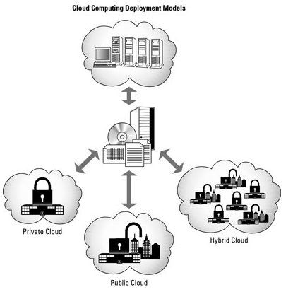
Deployment Model
There are four primary cloud deployment models :
Public Cloud
Private Cloud
Community Cloud
Hybrid Cloud

Slide 89
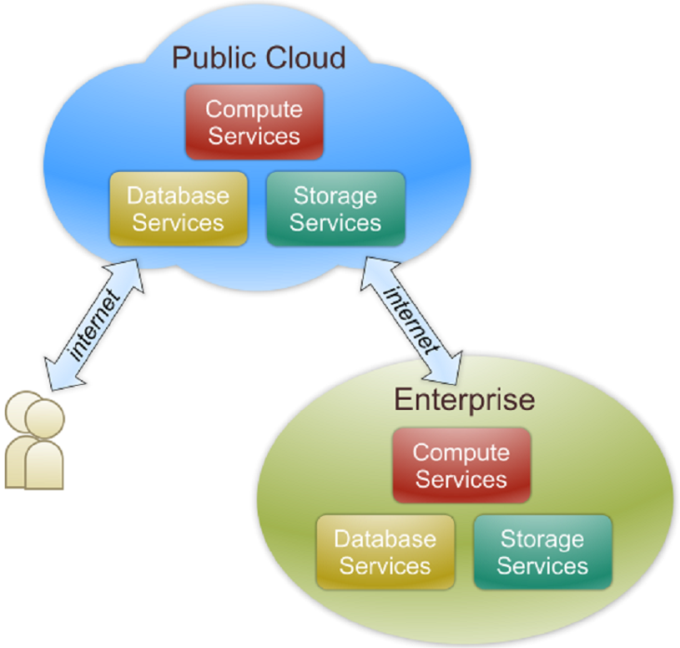
Public Cloud
Public cloud definition
The cloud infrastructure is made available to the general public or a large industry group and is owned by an organization selling cloud services.
Also known as external cloud or multi-tenant cloud, this model essentially represents a cloud environment that is openly accessible.
Basic characteristics :
Homogeneous infrastructure
Common policies
Shared resources and multi-tenant
Leased or rented infrastructure
Economies of scale - because infrastructure costs are spread across all users, thus allowing each individual client to operate on a low-cost

Slide 90
Examples of public clouds include
Amazon Elastic Compute Cloud (EC2),
IBM’s Blue Cloud,
Sun Cloud,
Google AppEngine and
Windows Azure Services Platform.
Most of the google services
Gmail, Google Doc, Spreadsheet
A public cloud is one based on the standard cloud computing model, in which a service provider makes resources, such as virtual machines (VMs), applications or storage, available to the general public over the internet. Public cloud services may be free or offered on a pay-per-usage model.

Slide 91
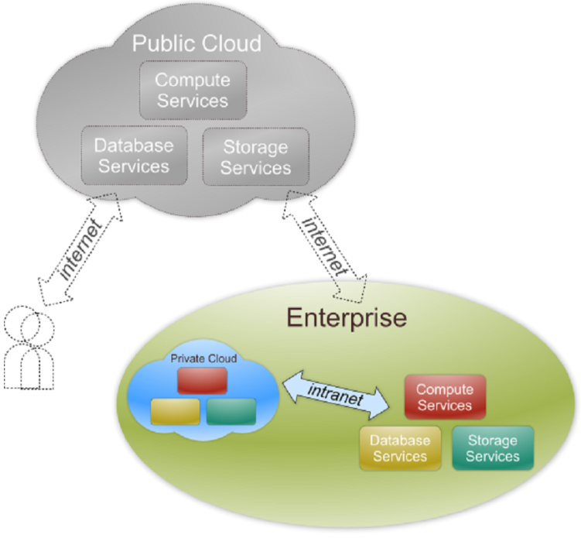
Private Cloud
Private cloud definition
The cloud infrastructure is operated solely for an organization. It may be managed by the organization or a third party and may exist on premise or off premise.
Also referred to as internal cloud or on-premise cloud, a private cloud intentionally limits access to its resources to service consumers that belong to the same organization that owns the cloud.
Basic characteristics :
Heterogeneous infrastructure
Customized and tailored policies
Dedicated resources
In-house infrastructure
End-to-end control

Slide 92
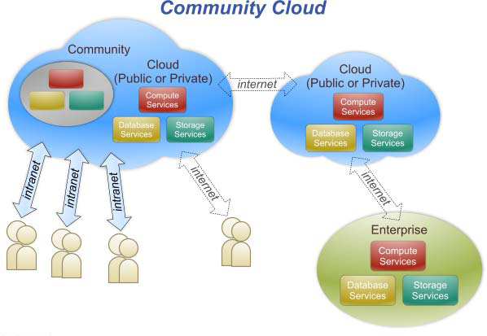
Community Cloud
Community cloud definition
The cloud infrastructure is shared by several organizations and supports a specific community that has shared concerns (e.g., mission, security requirements, policy, and compliance considerations).
Community clouds are often designed for businesses and organizations working on joint projects, applications, or research, which requires a central cloud computing facility for building, managing and executing such projects.

Slide 93
Community Cloud
(i) Healthcare Sector
Shared Patient Records: A consortium of hospitals and labs uses a community cloud to securely exchange patient data, ensuring HIPAA compliance, which is crucial for research and coordinated care.
(ii) Education Sector
Resource Sharing: Multiple universities or school districts use a shared platform for e-learning, administrative tasks, and sharing educational content, reducing individual IT costs and improving collaboration between institutions.

Slide 94
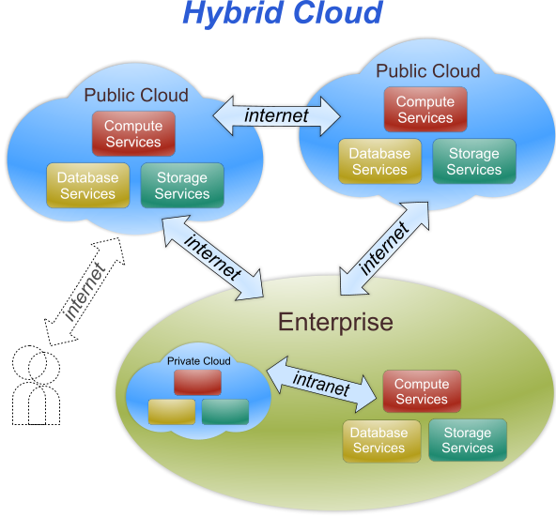
Hybrid Cloud
Hybrid cloud definition
The cloud infrastructure is a composition of two or more clouds (private, community, or public) that remain unique entities but are bound together by standardized or proprietary technology that enables data and application portability (e.g., cloud bursting for load-balancing between clouds).

Slide 95
Hybrid Cloud
An example of a hybrid cloud solution is an organization that wants to keep confidential information secured on their private cloud, but make more general, customer-facing content on a public cloud.
Cloud bursting is an application deployment model in which an application runs in a private cloud and burst into a public cloud when the demand for computing capacity spikes.
Cloud bursting in a hybrid cloud is a dynamic setup where an application runs in a private cloud (or on-premise) and automatically "bursts" into a public cloud to use extra resources when demand spikes, preventing performance issues, then scales back down, offering cost-efficiency by only paying for public cloud resources when needed

Slide 96
Role of Virtualization in Cloud-based Services
What is Virtualization?
The basic concept of virtualization is that a piece of software will function as a physical object, that is, it will “look” and “behave” like hardware
Virtualization is a key element of the cloud computing concept because it is the only way to
build a truly efficient Cloud

Slide 97
Role of Virtualization in Cloud-based Services
How Virtualization is Different from Cloud Computing?
Virtualization software allows multiple operating systems and applications to run on the same server at the same time, and, as a result, lowers costs and increases efficiency of a company’s existing hardware.

Slide 98
Server virtualization
Server virtualization is a process that creates and abstracts multiple virtual instances on a single server.
Server space is conserved by consolidating multiple machines into a single server that then runs several virtual environments.

Slide 99
Server virtualization
Server virtualization is a cost-effective way to provide web hosting services and effectively utilize existing resources in IT infrastructure. Without server virtualization, servers only use a small part of their processing power

Slide 100
Storage virtualization
Disk storage used to be a simple matter. If a business needed more, it simply purchased a larger disk drive.
While storages continue to grow to handle all the data, they becomes much harder to manage. Virtualization technology is a great answer to the overwhelming amount of data businesses accumulate today.
It adds an additional layer of software between systems and servers, and applications no longer need to know where specific data resides. It is managed as if it is a single resource.
Servers will see the virtualization layer as one single storage device and each individual storage device sees the layer as its only server.

Slide 101
Network virtualization
allows management and monitoring of an entire network as a single entity.
Primarily, it is designed to automate administrative tasks, disguising the complexity of the network.
Each server (and service) is considered a part of one pool of resources to be used without worry about its physical components.

Slide 102
Understanding the Advantages of Virtualization
The best way to think about the role of virtualization is to understand the difference between private and public clouds.
in a private cloud environment, a business owns or leases both the hardware and the software that provides the service consumption.
This is in-house virtualization, and the business maintains full management and control.

Slide 103
Understanding the Advantages of Virtualization
The public cloud environment is one in which all of the virtualization is housed somewhere else, and a vendor provides the service to clients on a fee basis.
In the public cloud, there are “co-tenants” in the same cloud, and clients pay for the specific services they use, as they use them.

Slide 104
Virtualization in Private Cloud perspective
A private cloud is thus its own virtualized world.
It gives customers more control, along with flexibility to manage their own systems, on top of every other benefit of the cloud.
Plus, the owner does not have to worry about coexisting with “bad neighbors” or possible slowdowns in performance

Slide 105
Virtualization in Private Cloud perspective
benefits of private virtualization include the following:
Maximizing existing resources: Virtualization tools will allow a user to keep physical systems to a minimum, getting greater value out of existing servers.
Running multiple applications and their operating systems on the same hardware.
Costs are direct but are fixed. All costs for management, administration, and other requirements are within the in-house IT budget.

Slide 106
Virtualization in Public Cloud perspective
Virtualized services through a public cloud environment are usually preferable for businesses that have smaller IT staffs and that tend to have fewer security concerns.

Slide 107
Virtualization in Public Cloud perspective
IT is delegated to a reliable partner. Because there is a service provider, administration and supportive services are taken care of elsewhere. In-house IT staff remain available for other business purposes.
Setup is easy and fast. And servers, hardware, and software license expenditures are eliminated.
Pay-as-you-use. Cloud-based services are charged based upon scope of use,
Scalability. Cloud services allow both permanent and temporary scaling. Thus, a business can off-load high-demand requirements at any time, even on a temporary basis, and pay only for the time of that off-load.

Slide 108
Cloud Infrastructure Management
Features available in Virtual Infrastructure Manager(VIM):
Virtualization Support
Self Service, On Demand Resource Provisioning
Multiple backend hypervisors
Storage Virtualization
Interface to public clouds
Virtual Networking
Dynamic Resource allocation
Virtual Clusters
Reservation and negotiation mechanism
High availability and Data Recovery

Slide 109
Challenges and Risk:
Security , Privacy and Trust
Data Lock in and standardization
Availability , Fault Tolerance and Disaster Recovery
Resource Management and Energy

Slide 110
Challenges And Risks
A signiﬁcant number of challenges and risks are inherent to cloud computing
User privacy, data security
Data Lock-In and Standardization
Availability of service, disaster recovery
Resource Management and Energy-Efﬁciency
Notes:
1.8 Challenges And Risks

Slide 111
Security, Privacy, and Trust
Information security is a main issue
Current cloud offerings are essentially public
Exposing the system to more attacks
Need to make cloud computing environments as secure as in-house IT systems
e.g., data encryption, VLANs, and ﬁrewalls
The trust toward providers is fundamental
To ensure the desired level of privacy for applications hosted in the cloud

Slide 112
Security, Privacy, and Trust (cont.)
Legal and regulatory issues also need attention
Providers may choose to locate data anywhere
The physical location of data centers determines the set of laws applied to the management of data
Speciﬁc cryptography techniques can not be used
They are not allowed in some countries
Country laws can impose that sensitive data are to be stored within national borders
e.g., patient health records
Notes:
1.8.1 Security, Privacy, and Trust

Slide 113
Data Lock-In and Standardization
A major concern of cloud computing users
Having their data locked-in by a certain provider
Users may want to move data and applications out from a provider that does not meet their requirements
Cloud computing infrastructures and platforms do not employ standard methods of storing user data and applications.
User data are not portable
CCIF (CC Interoperability Forum) was formed to work together, and they created UCI (unified cloud interface) to create a standard platform for cloud infrastructure
Notes:
1.8.2 Data Lock-In and Standardization

Slide 114
Data Lock-In and Standardization (cont.)
Open Virtual Format (OVF)
OVF is a specification that describes an open-standard, secure, efficient, portable and extensible format for packaging and distributing software for virtual machines.
Hardware virtualization
Aims at facilitating packing and distribution of software to be run on VMs
Virtual appliances can be made portable
Seamlessly run on hypervisor of different vendors
The OVF standard is independent of any particular hypervisor or processor architecture.
Notes:
1.8.2 Data Lock-In and Standardization

Slide 115
Availability, Fault-Tolerance, and Disaster Recovery
Users will have certain expectations about the service level to be provided
Once their applications are moved to the cloud
Availability of the service, its overall performance
What measures are to be taken when something goes wrong in the system or its components
Users seek for a warranty before they can comfortably move their business to the cloud
SLAs must be ideally set up between customers and cloud computing providers
To act as warranty
Notes:
1.8.3 Availability, Fault-Tolerance, and Disaster Recovery

Slide 116
Availability, Fault-Tolerance, and Disaster Recovery (cont.)
Including QoS requirements must be set between CSPs and Consumers
Speciﬁes the details of the service to be provided
Including availability and performance guarantees
Metrics must be agreed upon by all parties
Penalties for violating the expectations must also be approved
Notes:
1.8.3 Availability, Fault-Tolerance, and Disaster Recovery

Slide 117
Resource Management and Energy-Efﬁciency
One important challenge is the efﬁcient management of virtualized resource pools
Physical resources like CPU cores, disk space, and network bandwidth must be sliced and shared among virtual machines
Running potentially heterogeneous workloads
Dimensions to be considered include
Number of CPUs, amount of memory, size of virtual disks, and network bandwidth
Notes:
1.8.4 Resource Management and Energy-Efﬁciency

Slide 118
Resource Management and Energy-Efﬁciency (cont.)
Data centers consume large amounts of electricity
100 server racks can consume 1.3 MW of power
Another 1.3 MW are required by the cooling system
Costing USD 2.6 million per year
Besides monetary cost, Data centers signiﬁcantly impact the environment
In terms of CO2 emissions from the cooling systems

Slide 119
Benefits of Cloud computing architecture
Makes overall cloud computing system simpler.
Improves data processing requirements.
Helps in providing high security.
Makes it more modularized.
Results in better disaster recovery.
Gives good user accessibility.
Reduces IT operating costs.
Provides high level reliability.
Scalability.

Slide 120
Business Agility: Benefits and challenges to Cloud architecture
What is business agility?
What Is an Example of Agility in the Cloud?

Slide 121
Business Agility: Benefits and challenges to Cloud architecture
What is Cloud Agility?
Why is Cloud Agility Important for Businesses?

Slide 122
Business Agility: Benefits and challenges to Cloud architecture
Benefits of Achieving Cloud Agility
Achieving cloud agility offers several business-friendly benefits, including accelerating the time to market, increasing flexibility, and enhancing organizational value.

Slide 123
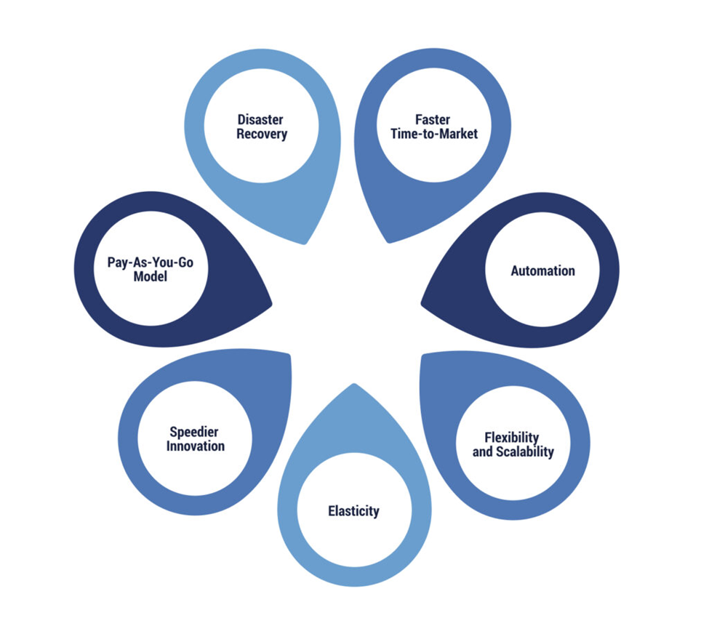
Business Agility: Benefits and challenges to Cloud architecture
Benefits of Achieving Cloud Agility

Slide 124
Business Agility: Benefits and challenges to Cloud architecture
Benefits of Achieving Cloud Agility
Faster Time-to-Market
Automation
Flexibility and Scalability
Elasticity

Slide 125
Business Agility: Benefits and challenges to Cloud architecture
Benefits of Achieving Cloud Agility
5. Speedier Innovation
6. Pay-As-You-Go Model
7. Disaster Recovery
Notes:
5.

Slide 126
Business Agility: Benefits and challenges to Cloud architecture
How to Build Cloud Agility in Your Cloud Environment?
You can incorporate cloud agility into your environment by utilizing the following:
Mult-cloud Strategy
Serverless Computing
CI/CD pipeline

Slide 127
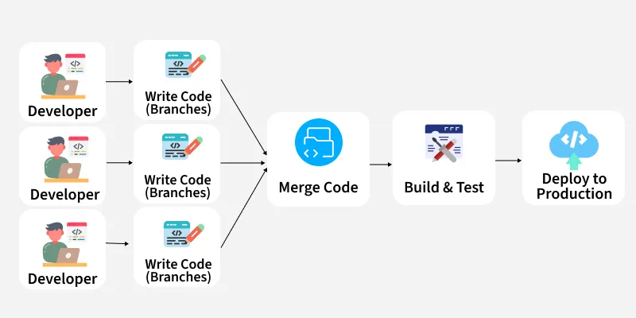
CI/CD pipeline
What is CI/CD?
Fig: Before CI/CD

Slide 128
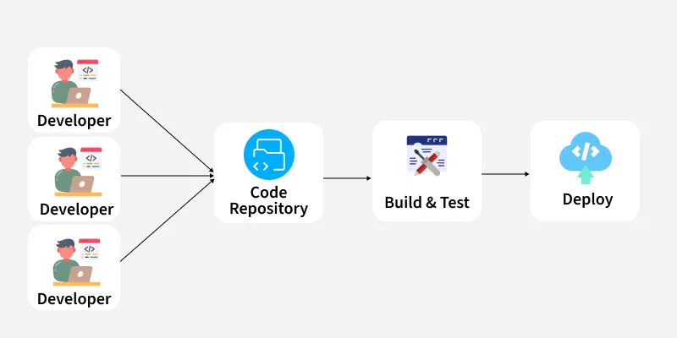
CI/CD pipeline
What is CI/CD?
Fig: After CI/CD

Slide 129
CI/CD pipeline
What is CI/CD?
Tools like Git, Jenkins, Docker, and Kubernetes automate everything from building to deployment, making the workflow transparent and collaborative. Bugs are fixed quickly, rollbacks are easier, and overall software delivery happens in hours instead of days

Slide 130
Disaster recovery
Disasters can be natural, such as floods, hurricanes, and earthquakes, or man-made, such as cyber-attacks and power outages.
Cloud disaster recovery is a set of strategies and services that leverage cloud computing to protect data, applications, and other IT resources from disasters and hardware failures.

Slide 131
How Does Cloud-Based Disaster Recovery Work?
Cloud disaster recovery works by replicating data and apps in a cloud-based environment using three primary strategies.:
Cold Disaster Recovery (Cold DR)
Warm Disaster Recovery (Warm DR)
Hot Disaster Recovery (Hot DR)

Slide 132
Disaster recovery
What Is Cloud Disaster Recovery (Cloud DR)?
Cloud disaster recovery is a set of strategies and services that leverage cloud computing to protect data, applications, and other IT resources from disasters and hardware failures.

Slide 133
Disaster recovery
Why Is Cloud Disaster Recovery Important?
Cloud disaster recovery quickly restores IT systems' functions, minimizing downtime and disruption to business operations
Maintaining operational resilience is vital, as 60% of small businesses close within six months of experiencing a cyber-attack, and 25% never reopen after a disaster.
Despite these statistics, only 54% of organizations have an established disaster recovery plan. Although 57% of surveyed companies have a second on-prem data center dedicated to disaster recovery, this approach can be expensive and complex.

Slide 134
Disaster recovery
How Does Cloud-Based Disaster Recovery Work?
Cold DR is the most straightforward and cost-effective disaster recovery approach but has the longest recovery time.
Cold DR involves storing data or virtual machine (VM) images in the cloud. However, they are not readily usable and require additional restoring steps, such as downloading up-to-date data or loading VM images.

Slide 135
Disaster recovery
How Does Cloud-Based Disaster Recovery Work?
Warm DR is a standby system that maintains up-to-date duplicates of data and apps in the cloud.
These duplicate resources are not actively processing data, but you can quickly activate them in a disaster.
Warm DR recovery is relatively fast, but there is still some downtime for the protected workloads.

Slide 136
Disaster recovery
How Does Cloud-Based Disaster Recovery Work?
Hot DR is the most expensive and intricate disaster recovery approach, offering the fastest recovery time with zero downtime.
Hot DR operates with a live parallel deployment, where data and workloads run concurrently in both the primary data center and the DR site.
Both sites share the same workload, staying synchronized and splitting the app traffic.
If disaster strikes one site, the other seamlessly continues operations without interruption.

Slide 137
Disaster recovery
Challenges of Cloud DR:
Migration costs.
Complex implementation.
Consistent connectivity.
Vendor lock-in.
Dependence on third-party providers.

